Slide 1
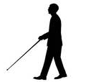
Haptic Belt for Visually Impaired
Nitish Malhotra
Paul Inglis
Aashish Chaddha

Slide 2
Contents
Indoor Mode
Outdoor Mode
System Architecture
Design Aspect

Slide 3
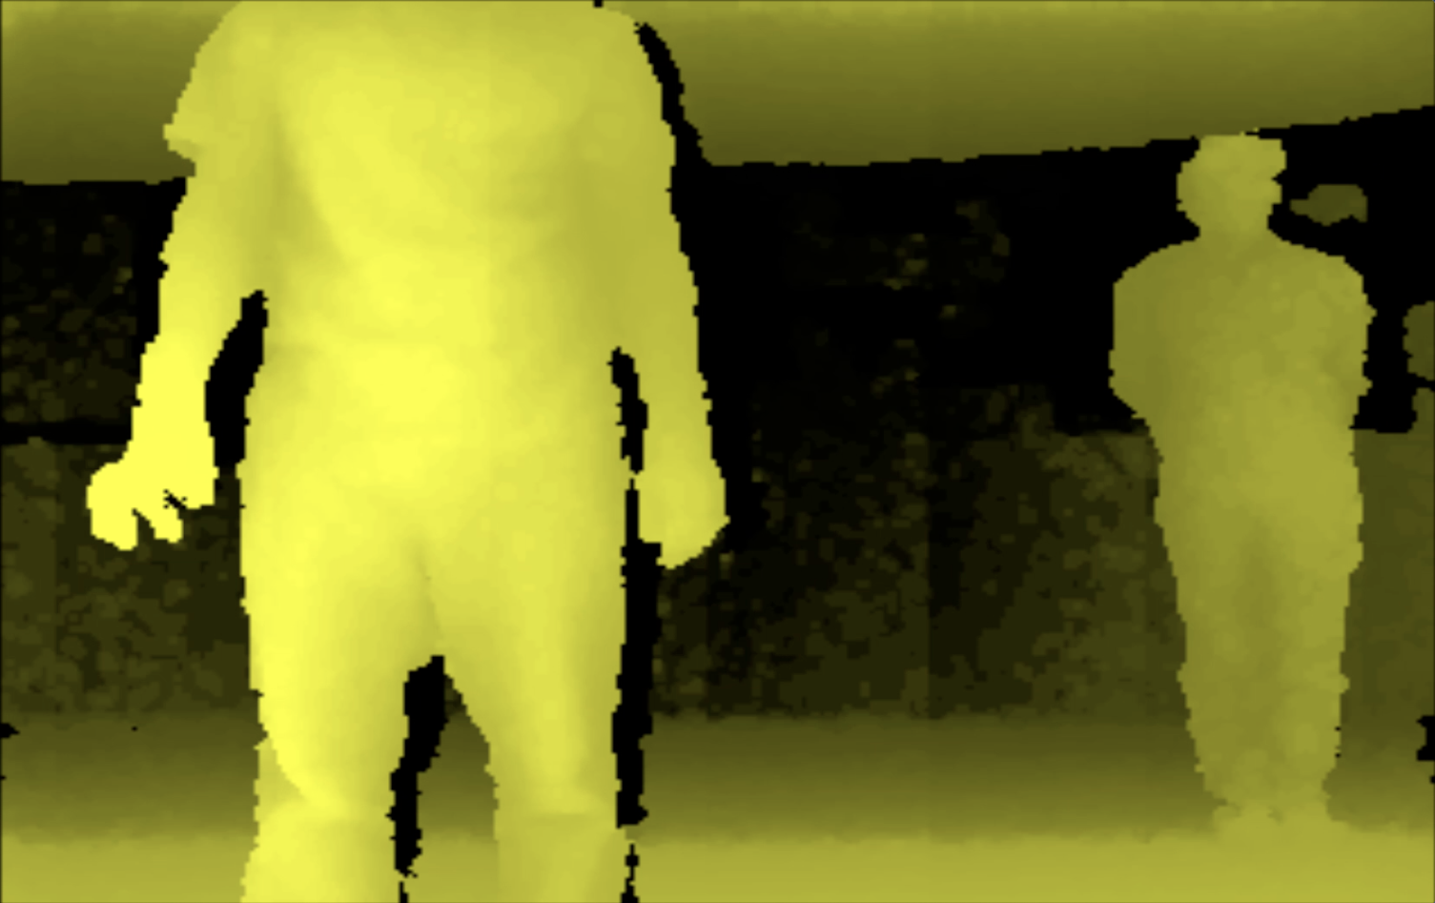

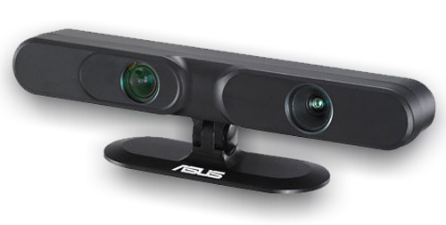
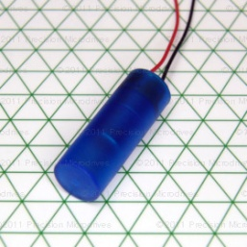
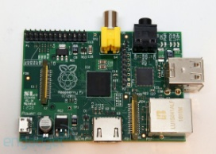
Indoor Obstacle Avoidance
Right
Center
Left
Overlapping zones for Obstacle Detection
Right Motor Range : 0 to 2/5th
Center Motor Range: 1/5th to 4/5th
Left Motor Range : 3/5th to 1
Zone1
Zone2
Zone3
Zone4
Zone5
Scenario –
Right motor PWM – 80%
Center motor PWM – 80%
Left motor PWM – 30%
+
+
=
Obstacle

Slide 4
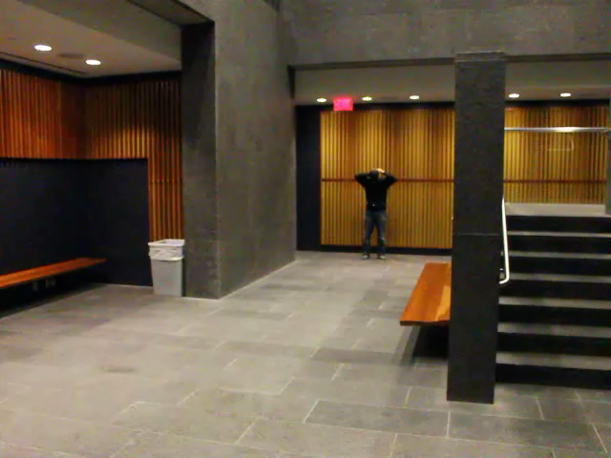

Slide 5
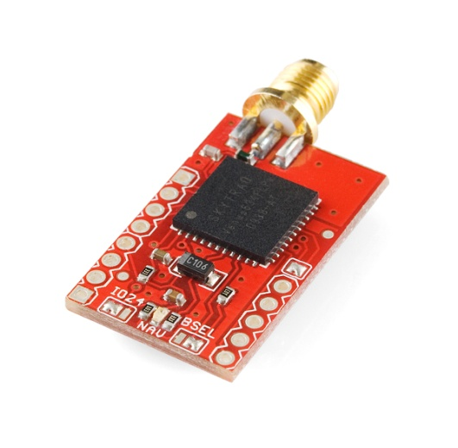
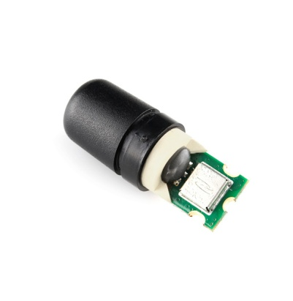
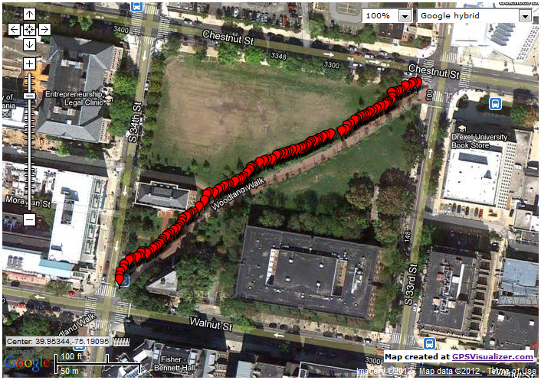
Outdoor GPS Assisted Navigation
Geo-Helix Antenna
GPS Module
A
B

Slide 6
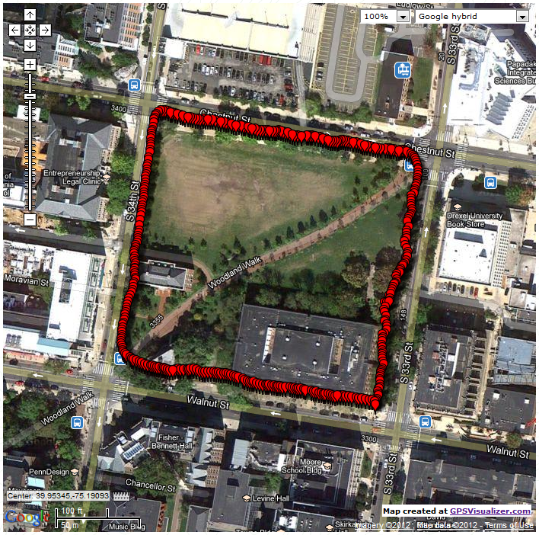
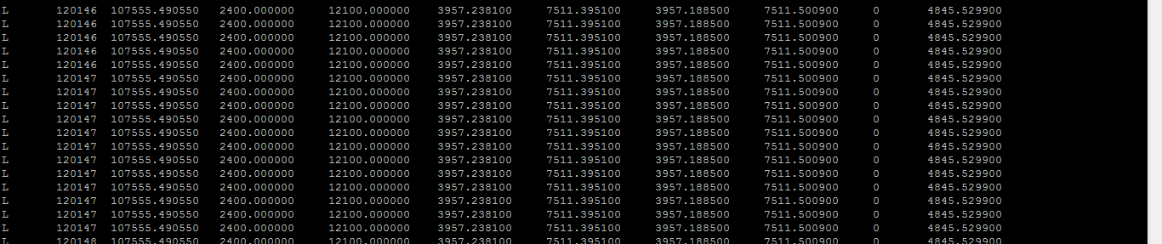
B
A
GPS Navigation –
Periodic feedback on current trajectory.
Forward / Backward
Left / Right
Waypoint arrival notification
C
D

Slide 7
System Architecture
Battery
Asus Xtion
Switch
ON / OFF
RaspberryPi
Voltage Regulator
Switch
Indoor / Outdoor
GPS
Vibration Motors

Slide 8
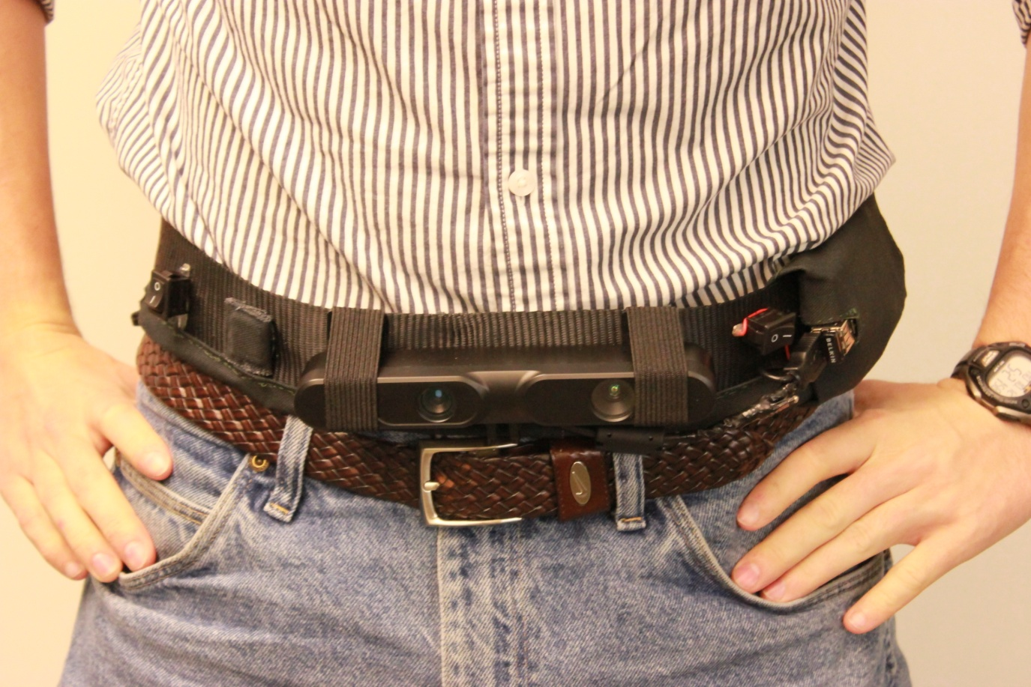
Design Aspects
A Fabric belt –
Light weight
Comfort
Comfortable
Unobtrusive
Compact / Portable
Light Weight
Battery Life (3+ Hours)
Streamlined
Simple
Easy to Use
Asus Xtion –
Cheaper and Smaller
Raspberry Pi – Cheaper and Smaller

Slide 9
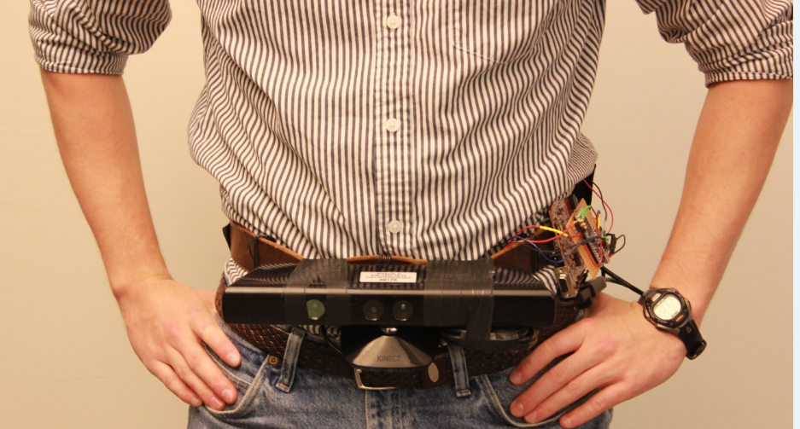
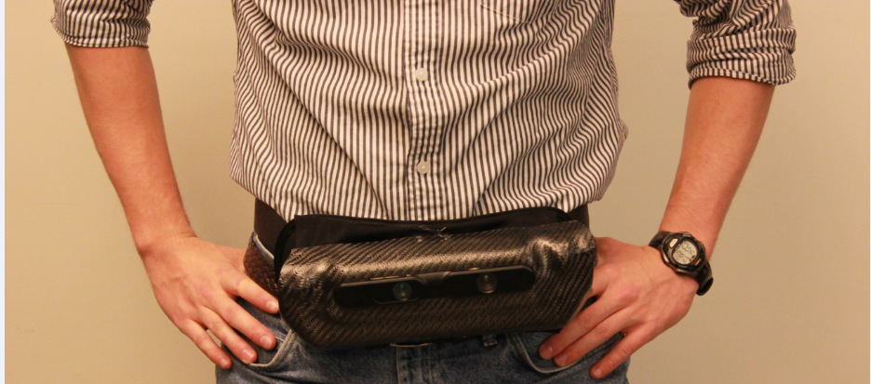


Slide 10
